Slide 1
Women Who Work in Correctional Facilities
Survey Results
International Corrections and Prison Association

Slide 2
Who Are We
Gary Hill
Susan Kunkle

Slide 3
Objectives For Today’s Session
To inform the audience on the research and evidence that was used to design the survey.
To highlight the results of the survey.
To identify issues of challenge where training is lacking
To identify the next steps.

Slide 4
The survey
Funding for the survey was provided by Kent State University – University Research Council.
Members of the Committee Developed the Survey
Dr. Susan Kunkle
Dr. Susan Jones
Ms. Taronica White
The Survey Research Lab at Kent State handled the logistics and assisted us with clarity relative to the questions and other matters. The Committee was part of a team of researchers from Kent State University including Dr. Gregory Gibson, Rusty Schnellinger, M.A. and Nicole Perrone, M. A.
Dr. Ramona McNeal, Associate Professor, University of Northern Iowa, reviewed and codified the data for additional analysis.
Interviews with Correctional Officers (female), Police Officers (female), Researchers, Practitioners, and Justice System Professionals (Kunkle, 2018-2019).

Slide 5
Countries Represented in the data set

Slide 6
What are some of the things that we learned
We learned that there is significant training addressing issues of challenge for female and male employees occurring across the membership base of ICPA.
Recruitment and retention are challenging in multiple jurisdictions.
Developing a more comprehensive approach to responding to vicarious or secondary trauma is a need reflected in other outcomes.
Addressing the issue of boundary violations is a need.
Workplace violence as reflected in sexual and sexualized harassment is a need.
Focusing on issues unique to the Trans population is primarily a policy need follow by a training need.

Slide 7
Training Concerns And Topics

Slide 8
Institute for Criminal Policy Research School of Law, Birkbeck, University of London ICPS@bbk.ac.uk
Men and women who work in prisons need to be carefully chosen to make sure that they have the appropriate personal qualities and educational background.
They then need to be given proper training in the principles which should underlie their work and in the human and technical skills which are required.
Throughout their careers they should be given the opportunity to develop and expand these skills and to keep up to date with the latest thinking on prison issues.
Source: A Human Rights Approach to Prison Management: Handbook for Prison Staff (3rd edition)

Slide 9
About Training and learning with an adult population
We need to use proven methods to maximize learning including evidence on learner characteristics, technology, development, design, delivery, and evaluation (Clark 2010).
Adults typically become ready to learn when they experience a need to cope with a situation or perform a task (Knowles, Holton, & Swanson 1998) .
Adults’ orientation to learning is life-centered, problem-centered, and contextual.
Correctional agencies around the globe are challenged by an increasingly transient workforce, exponential growth in technology, and continued budget cuts (National Institute of Corrections).

Slide 10
Training Does Not = Competency

Slide 11
Gender Specific Training For Staff about staff
“Gender equality training provides participant(s) with the relevant knowledge, skills and values that allow them to contribute to the effective implementation of the gender mainstreaming strategy in their field, organisation, institution or country”.
European Institute for Gender Equality
https://eige.europa.eu/gender-mainstreaming/toolkits/gender-equality-training/what-gender-equality-training-get

Slide 12
Leadership Training
Gender Equality
On an institutional level: Concerns of women and men are considered, leading to better-informed policies and decision-making and improved organizational practices.
European Institute for Gender Equality
https://eige.europa.eu/gender-mainstreaming/toolkits/gender-equality-training/what-gender-equality-training-get

Slide 13
Does your agency provide staff with specific training regarding how to work with inmates who are mentally ill?
Although there do not appear to be sex differences in the overall prevalence of mental and behavioral disorders, there are significant differences in the patterns and symptoms of the disorders (World Health Organization, 2002).
https://www.who.int/mental_health/prevention/genderwomen/en/

Slide 14
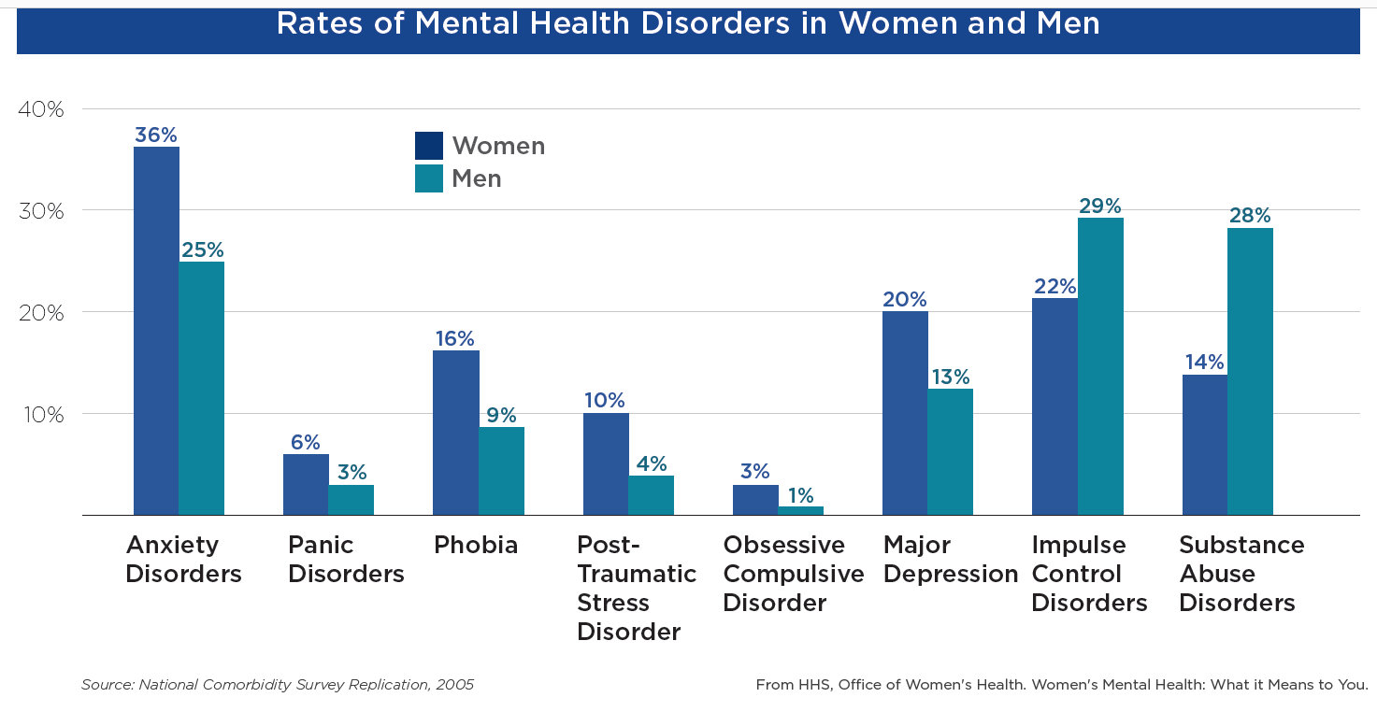
https://www.psychiatry.org/psychiatrists/cultural-competency/education/mental-health-facts

Slide 15
Training Topics mentioned in Unique comments
General Topics (24)
Gender Specific (9)
Mental Health and Inmates (5)
Leadership (5)
Management of Inmates (3)
Specific Topics (12)
Human Behavior
Interpersonal Relationship Skills
Reentry
Cognitive Behavioral Therapy
Relational Corrections
Restorative Justice
Conflict Resolution
Human Rights
Antibullying
Trans population (3)

Slide 16
Cognitive Behavioral Therapy
Cognitive behavioral therapy (CBT) is a problem-focused, therapeutic approach that attempts to help people identify and change dysfunctional beliefs, thoughts, and patterns of behavior that contribute to their problem behaviors (Lipsey, Landenberger, and Wilson 2007).
Cost Benefit Analysis was conducted by Aos and Drake (2013) who estimated that cost for each participant is approximately $419.
Due to reductions in crimes committed by adult offenders, CBT has a benefit-to-cost ratio of $24.72; that is, for one dollar spent on CBT programming, there is a benefit of $24.72 (Aos & Drake, 2013).
National Institute of Justice https://www.crimesolutions.gov/practicedetails.aspx?id=57

Slide 17
What is the most pressing training issue?
“Male Staff trained in how to work with and Empower Women”

Slide 18
Recruitment and Retention

Slide 19
Occupational Handbook – U.S. Dept. of Labor (2019)
Working in a correctional institution can be stressful and dangerous.
Correctional officers and jailers may become injured in confrontations with inmates, and they have one of the highest rates of injuries and illnesses of all occupations.
Correctional officers usually work full time on rotating shifts.
Because jail and prison security must be provided around the clock, officers work all hours of the day and night, including weekends and holidays.
Many officers are required to work overtime.
Bureau of Labor Statistics, U.S. Department of Labor, Occupational Outlook Handbook, Correctional Officers and Bailiffs, https://www.bls.gov/ooh/protective-service/correctional-officers.htm

Slide 20
Recruitment: Does Your agency Struggle to recruit qualified female corrections personnel?

Slide 21
Retention: Does Your agency Struggle to retain qualified female corrections personnel?

Slide 23
Secondary/Vicarious Trauma

Slide 24
What is vicarious trauma? https://vtt.ovc.ojp.gov/
Vicarious trauma is an occupational challenge for people working and volunteering in the fields of victim services, law enforcement, emergency medical services, fire services, and other allied professions, due to their continuous exposure to victims of trauma and violence.
This work-related trauma exposure can occur from such experiences as listening to individual clients recount their victimization; looking at videos of exploited children; reviewing case files; hearing about or responding to the aftermath of violence and other traumatic events day after day; and responding to mass violence incidents that have resulted in numerous injuries and deaths.
(Office for Victims of Crime, 2019)

Slide 25
Does your agency provide training to staff on trauma exposure and its effects on staff in the workplace?

Slide 26
https://www.middlesexsheriff.org/sites/middlesexsheriff/files/uploads/correctionalofficerwellnesssafety_litreview.pdf

Slide 27
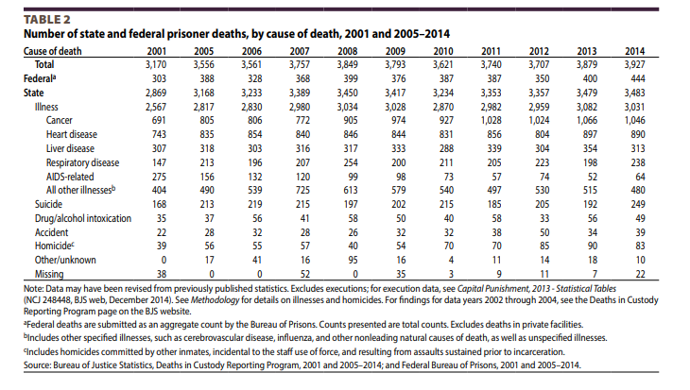
Does Your Agency Provide Training on Suicide in the workplace?

Slide 28
What type of support services are provided to staff in your agency?
Item | Frequency “Yes” | Valid Percent “Yes”
Employee assistance programs from an outside provider | 95 | 67.9%
Peer support services provided by co-workers | 85 | 60.7%
Health and wellness management through an insurance provider | 74 | 52.9%
Other (Please specify): | 13 | 9.3%
Don't know | 7 | 5.0%
Prefer to not answer | 3 | 2.1%

Slide 29
Vicarious Trauma Alerts

Slide 30
The Vicarious Trauma Toolkit Office of Victims of Crime (2019)
To maintain the health and wellness of staff, vicarious trauma-informed organizations recognize links between health/wellness and staff satisfaction and productivity; devote time and resources to promoting staff well-being; encourage and provide health and wellness activities; and incorporate wellness into policies and practices.
https://vtt.ovc.ojp.gov/tools-for-law-enforcement/staff-health-and-wellness

Slide 31
Boundary Violations

Slide 32
Dr. Susan Jones
“The boundary violations that occur in correctional facilities involve a wide range of behaviors but the violations that seem to get the most public attention are ones that involve sexual contact between inmates and correctional employees. Although sexual abuse of inmates by employees is a serious issue, this type of behavior is merely one stage on a progression of boundary violations”.
http://www.corrections.com/news/article/46184-model-to-increase-understanding-of-boundary-violations-female-correctional-employees-with-male-inmates-part-1

Slide 33
Boundary Violations (8)
In 2015, correctional administrators reported 24,661 allegations of sexual victimization in prisons, jails, and other adult correctional facilities.
More than half (58%) involved sexual victimization by staff toward inmates, and the remainder (42%) involved sexual victimization by inmates towards other inmates.
About 8% (1,473) of the allegations were substantiated based on completed investigations.
Bureau of Justice Statistics 2018 NCJ 251146 https://www.bjs.gov/content/pub/pdf/svraca1215.pdf

Slide 34
Thank you
Thank you for being an important part of today’s session.
Thank you to those who took time out from a busy schedule to complete the on-line survey.
Thank you to the International Corrections and Prison Association for the opportunity to delve into this important and timely topic.
Thank you to Fraser Bryans and Aleksandar Petrov for your direction and guidance.

